Slide 1
Spatial Domain Filtering
Dr. Ganga Holi,
Professor, Dept of CSE, KSIT.

Slide 2
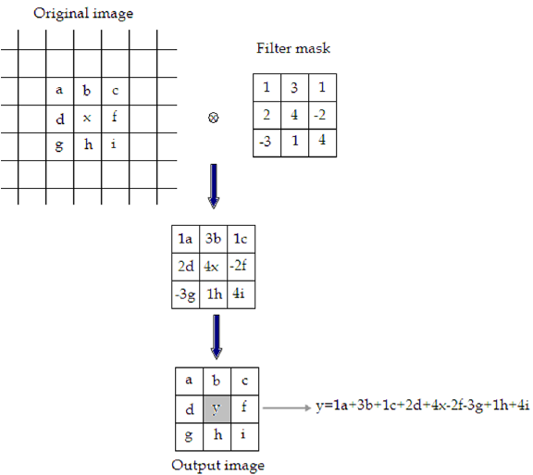
Spatial Domain Filtering

